Slide 1
C Programming Error Types
While writing c programs, errors also known as bugs
may occur unwillingly which may prevent the program to compile and run correctly as per the expectation of the programmer.
Basically there are three types of errors in c programming:
Runtime Errors
Compile Errors
Logical Errors

Slide 2
C Runtime Errors
C runtime errors are those errors that occur during the execution of a c program and generally occur due to some illegal operation performed in the program.
Examples of some illegal operations that may produce runtime errors are:
Dividing a number by zero
Trying to open a file which is not created
Lack of free memory space

Slide 3
Compile Errors
Compile errors are those errors that occur at the time of compilation of the program.
C compile errors may be further classified as:
Syntax Errors
Ex: int a,b:
will produce syntax error as the statement is terminated with : rather than ;
Semantic Errors
Ex: b+c=a;
We are trying to assign value of a in the value obtained by summation of b and c which has no meaning in c. The correct statement will be:
a=b+c;

Slide 4
Logical Errors
Logical errors are the errors in the output of the program.
The presence of logical errors leads to undesired or incorrect output
Are caused due to error in the logic applied in the program to produce the desired output.
logical errors could not be detected by the compiler, and thus, programmers has to check the entire coding of a c program line by line.

Slide 5
UNIT 5
CONTROL STATEMENTS

Slide 6
The statements which alter the flow of execution of the program are known as control statements.
Sometimes we have to do certain calculations/tasks depending on whether a condition or test is true or false.
Similarly, it is necessary to perform repeated actions or skip some statements.
For these operations, control statements are needed.

Slide 7
Two types of control statements
Decision Making(or branching) Statements
If statement
If…else statement
Else...if statement
Nested if...else statement
Switch statement
Loop or Repeating Construct
For loop
While loop
Do…while loop
NOTE:
Branching is deciding what actions to take
looping is deciding how many times to take a certain action.

Slide 8
C - Decision Making
programmer specifies one or more conditions to be evaluated
if the condition is determined to be true, a statement is executed and optionally other statements to be executed if the condition is determined to be false.

Slide 9
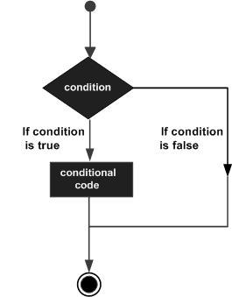
Typical decision making structure found in most of the programming languages −

Slide 10
if statement
An if statement consists of a Boolean expression followed by one or more statements.
Syntax
if(boolean_expression) { /* statement(s) will execute if the boolean expression is true */ }

Slide 11
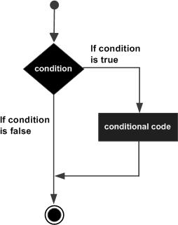
Flow Diagram

Slide 12
If.. statement
If the Boolean expression evaluates to true, then the block of code inside the 'if' statement will be executed. If the Boolean expression evaluates to false, then the first set of code after the end of the 'if' statement (after the closing curly brace) will be executed.
C programming language assumes any non-zero and non-null values as true and if it is either zero or null, then it is assumed as false value.

Slide 13
Output: a is less than 20; value of a is : 10
#include <stdio.h> int main () { /* local variable definition */ int a = 10; /* check the boolean condition using if statement */ if( a < 20 ) { /* if condition is true then print the following */ printf("a is less than 20\n" ); } printf("value of a is : %d\n", a); return 0; }

Slide 14
if...else statement
An if statement can be followed by an optional else statement, which executes when the Boolean expression is false.
Syntax
if(boolean_expression) { /* statement(s) will execute if the
boolean expression is true */ } else { /* statement(s) will execute if the
boolean expression is false */ }

Slide 15
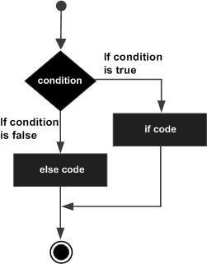
Flow Diagram

Slide 16
if.. else statement
If the Boolean expression evaluates to true, then the if block will be executed, otherwise, the else block will be executed.
C programming language assumes any non-zero and non-null values as true, and if it is either zero or null, then it is assumed as false value.

Slide 17
Output a is not less than 20; value of a is : 100
#include <stdio.h> int main () { /* local variable definition */ int a = 100; /* check the boolean condition */ if( a < 20 ) { /* if condition is true then print the following */ printf("a is less than 20\n" ); } else { /* if condition is false then print the following */ printf("a is not less than 20\n" ); } printf("value of a is : %d\n", a); return 0; }

Slide 18
if...else if..else statements
An if statement can be followed by an optional else if...else statement, which is very useful to test various conditions using single if...else if statement.
When using if...else if..else statements, there are few points to keep in mind −
An if can have zero or one else's and it must come after any else if's.
An if can have zero to many else if's and they must come before the else.
Once an else if succeeds, none of the remaining else if's or else's will be tested.

Slide 19
Syntax
if(boolean_expression 1) { /* Executes when the boolean
expression 1 is true */ } else if( boolean_expression 2) { /* Executes when the boolean
expression 2 is true */ } else if( boolean_expression 3) { /* Executes when the boolean
expression 3 is true */ } else { /* executes when the none of the
above condition is true */
}

Slide 20
#include <stdio.h> int main () { /* local variable definition */ int a = 100; /* check the boolean condition */ if( a == 10 ) { /* if condition is true then print the following */ printf("Value of a is 10\n" ); } else if( a == 20 ) { /* if else if condition is true */ printf("Value of a is 20\n" ); } else if( a == 30 ) { /* if else if condition is true */ printf("Value of a is 30\n" ); } else { /* if none of the conditions is true */ printf("None of the values is matching\n" ); } printf("Exact value of a is: %d\n", a ); return 0; }

Slide 21
Nested if statements
It is always legal in C programming to nest if-else statements, which means you can use one if or else if statement inside another if or else if statement(s).
Syntax:
if( boolean_expression 1) {
/* Executes when the boolean
expression 1 is true */
if(boolean_expression 2) {
/* Executes when the boolean
expression 2 is true */
}
}

Slide 22
Output Value of a is 100 and b is 200 Exact value of a is : 100 Exact value of b is : 200
#include <stdio.h> int main () { /* local variable definition */ int a = 100; int b = 200; /* check the boolean condition */ if( a == 100 ) { /* if condition is true then check the following */ if( b == 200 ) { /* if condition is true then print the following */ printf("Value of a is 100 and b is 200\n" ); } } printf("Exact value of a is : %d\n", a ); printf("Exact value of b is : %d\n", b ); return 0; }

Slide 23
Loop Control Statements
Loop control statements change execution from its normal sequence.
When execution leaves a scope, all automatic objects that were created in that scope are destroyed.
C supports the following control statements.
break statement
continue statement
goto statement

Slide 24
Break statement
The break statement in C programming has the following two usages −
When a break statement is encountered inside a loop, the loop is immediately terminated and the program control resumes at the next statement following the loop.
It can be used to terminate a case in the switch statement
SYNTAX:
break;

Slide 25
Flow diagram

Slide 26
#include <stdio.h>
int main () {
/* local variable definition */
int a = 10;
/* while loop execution */
while( a < 20 ) {
printf("value of a: %d\n", a);
a++;
if( a > 15)
{
/* terminate the loop using break statement */
break;
}
}
return 0;
}

Slide 27
Continue Statement
The continue statement in C programming works somewhat like the break statement. Instead of forcing termination, it forces the next iteration of the loop to take place, skipping any code in between
For the for loop, continue statement causes the conditional test and increment portions of the loop to execute.
For the while and do...while loops, continue statement causes the program control to pass to the conditional tests.
SYNTAX
continue;

Slide 28
FLOW DIAGRAM

Slide 29
#include <stdio.h>
int main () {
/* local variable definition */
int a = 10;
/* do loop execution */
do {
if( a == 15) {
/* skip the iteration */
a = a + 1;
continue;
}
printf("value of a: %d\n", a);
a++;
} while( a < 20 );
return 0;
}

Slide 30
goto statement
To alter the normal sequence of program execution by unconditionally transferring control to some other part of the program.
General expression:
goto label:
Here, label is an identifier used to label the target statement to which the control would be transferred.

Slide 31
Generally the use of goto statement is avoided as it makes program illegible.
This statement is used in unique situations like:
Branching around statements or group of statements under certain conditions
Jumping to the end of a loop under certain conditions, thus bypassing the remainder of the loop during current pass.
Jumping completely out of the loop under certain conditions, terminating the execution of a loop.

Slide 32
Switch Statement
Switch statement allows a program to select one statement for execution of a set of alternatives.
Only one of the possible statements will be executed, the remaining statements will be skipped.
The multiple usage of IF ELSE statement increases the complexity of the program, hard to read and difficult to follow the program.
Switch statement removes these disadvantages by using a simple and straight forward approach.

Slide 33
Syntax
switch(expression) { case caseConstant1: statement(s); break; case caseConstant2:
statement(s); break; .
.
. default:
statement; }

Slide 34
The following rules apply to a switch statement
The expression used in a switch statement must have an integral or enumerated type.
You can have any number of case statements within a switch. Each case is followed by the value to be compared to and a colon.
The caseConstant for a case must be the same data type as the variable in the switch, and it must be a constant or a literal.
When the variable being switched on is equal to a case, the statements following that case will execute until a break statement is reached.
When a break statement is reached, the switch terminates, and the flow of control jumps to the next line following the switch statement.
Not every case needs to contain a break. If no break appears, the flow of control will fall through to subsequent cases until a break is reached.
A switch statement can have an optional default case, which must appear at the end of the switch. The default case can be used for performing a task when none of the cases is true. No break is needed in the default case.

Slide 35
Write a program to make a menu like
#include <stdio.h>
int main(void){
int choice;
LOOP:
printf("Select 1 for file, 2 for Edit and 3 for Save\n");
printf("1==> file\n2==>Edit\n3==> Save\n");
scanf("%d",&choice);
switch(choice){
case 1:
printf("\nYou have chosen File Menu Item\n");
break;
case 2:
printf("\nYou have chosen Edit Menu Item\n");
break;
case 3:
printf("\nYou have chosen Save Menu Item\n");
break;
default:
printf("\nINVALID OPTION PLEASE TRY AGAIN\n");
goto LOOP;
}
}

Slide 36
Loop or Repeating Construct
You may encounter situations, when a block of code needs to be executed several number of times.
Programming languages provide various control structures that allow for more complicated execution paths.
A loop statement allows us to execute a statement or group of statements multiple times.

Slide 37
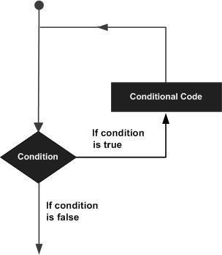
Given below is the general form of a loop statement in most of the programming languages −

Slide 38
for loop
A for loop is a repetition control structure that allows you to efficiently write a loop that needs to execute a specific number of times.
The syntax of a for loop in C programming language is −
for(init ; condition; increment){ statement(s); }

Slide 39
Here is the flow of control in a 'for' loop −
The init step is executed first, and only once. This step allows you to declare and initialize any loop control variables.
Next, the condition is evaluated. If it is true, the body of the loop is executed. If it is false, the body of the loop does not execute and the flow of control jumps to the next statement just after the 'for' loop.
After the body of the 'for' loop executes, the flow of control jumps back up to the increment statement. This statement allows you to update any loop control variables. This statement can be left blank, as long as a semicolon appears after the condition.
The condition is now evaluated again. If it is true, the loop executes and the process repeats itself (body of loop, then increment step, and then again condition). After the condition becomes false, the 'for' loop terminates.

Slide 40
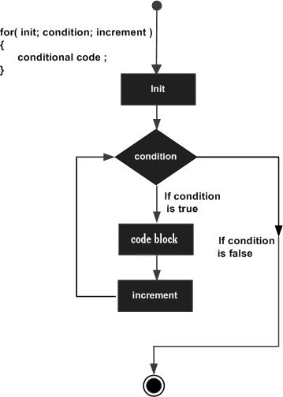
Flow Diagram

Slide 41
#include <stdio.h> //FOR LOOP int main () { int a; /* for loop execution */ for( a = 10; a < 20; a = a + 1 ){ printf("value of a: %d\n", a); } return 0; }
OUTPUT
When the above code is compiled and executed, it produces the following result −
value of a: 10 value of a: 11 value of a: 12 value of a: 13 value of a: 14 value of a: 15 value of a: 16 value of a: 17 value of a: 18 value of a: 19

Slide 42
While loop
A while loop in C programming repeatedly executes a target statement as long as a given condition is true.
Syntax:
while(condition) {
statement(s);
}
statement(s) may be a single statement or a block of statements.
The condition may be any expression, and true is any nonzero value.
The loop iterates while the condition is true.

Slide 43
Flow Diagram

Slide 44
#include <stdio.h>
void main () {
/* local variable definition */
int a = 10;
/* while loop execution */
while( a < 20 ) {
printf("value of a: %d\n", a);
a++;
}
}
OUTPUT:
value of a: 10
value of a: 11
…........
..........
value of a: 19

Slide 45
do-while loop
Unlike for and while loops, which test the loop condition at the top of the loop, the do...while loop in C programming checks its condition at the bottom of the loop.
A do...while loop is similar to a while loop, except the fact that it is guaranteed to execute at least one time.

Slide 46
Syntax
do {
statement(s);
} while( condition );
conditional expression appears at the end of the loop, so the statement(s) in the loop executes once before the condition is tested.

Slide 47
Flow diagram

Slide 48
#include <stdio.h>
void main () {
/* local variable definition */
int a = 10;
/* do loop execution */
do {
printf("value of a: %d\n", a);
a = a + 1;
}while( a < 20 );
}
OUTPUT:
value of a: 10
value of a: 11
….
....
value of a: 19

Slide 49
s.no. | while | do--while
1 | While loop is entry-controlled loop i.e. test condition is evaluated first and body of loop is executed only if this test is true. | do—while loop is exit-controlled loop. i.e. the body of the loop is executed first without checking condition and at the end of body of loop, the condition is evaluated for repetition of next time
2 | The body of the loop may not be executed at all if the condition is not satisfied at the very first attempt. | The body of loop is always executed at least once.
3 | Syntax: while(test expression){ body of loop } | Syntax: do { body of loop }while(test expression);
4 | show flowchart of while loop | Show flowchart of do—while loop

Slide 50
Nested loops in C
C programming allows to use one loop inside another loop.
The inner loop is said to be nested within the outer loop.
nested for loop
nested while loop
nested do...while loop

Slide 51
nested for loop
for ( init; condition; increment ) {
for ( init; condition; increment ) { statement(s);
}
statement(s);
}

Slide 52
nested while loop
while(condition) {
while(condition) {
statement(s);
}
statement(s);
}

Slide 53
Nested do...while loop
do {
statement(s);
do {
statement(s);
}while( condition );
}while( condition );

Slide 54
#include <stdio.h>
void main () {
/* local variable definition */
int i, j;
for(i = 2; i<100; i++) {
for(j = 2; j <= (i/j); j++) {
if(!(i%j)) {
break;
}
if(j > (i/j)){
printf("%d is prime\n", i);
}
}
}

Slide 55
exit function
The C library function void exit(int status) terminates the calling process immediately.
#include <stdio.h>
#include <stdlib.h>
int main () {
printf("Start of the program....\n"); printf("Exiting the program....\n");
exit(0);
printf("End of the program....\n");
return(0);
}

Slide 56
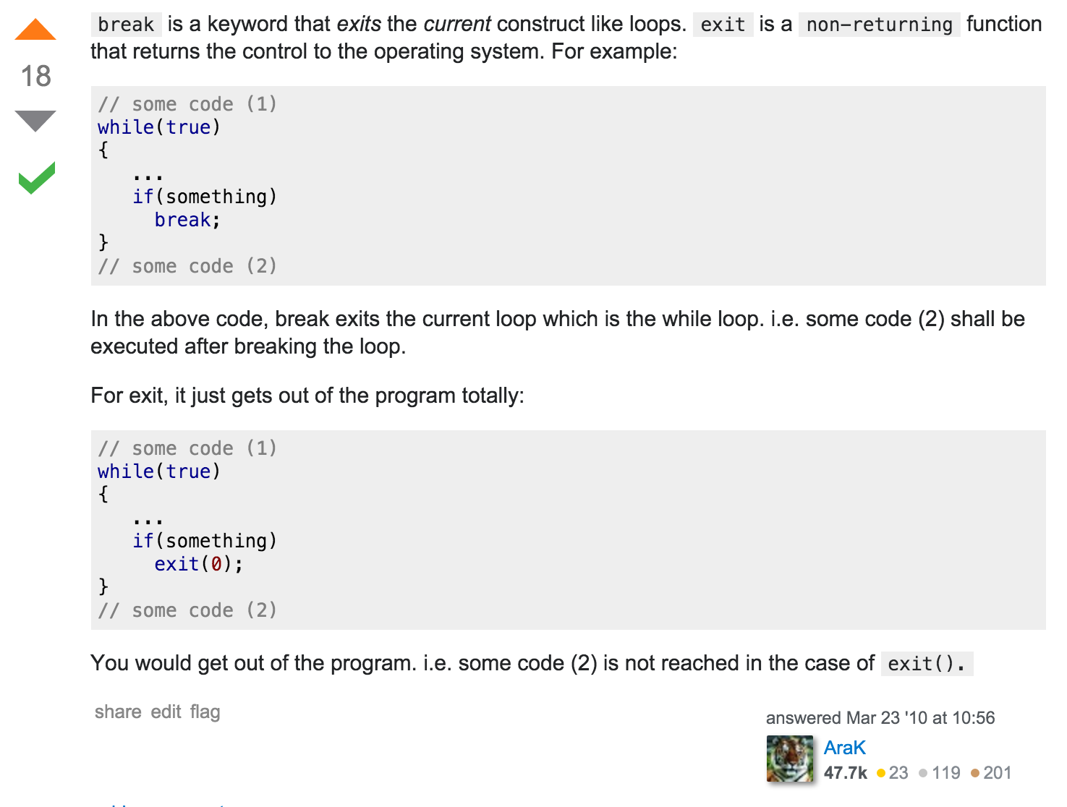

Slide 57
References
A text book of C programming - Ram datta bhatta
Tutuorialspoint.com
http://stackoverflow.com/questions/2499216/what-are-the-differences-between-break-and-exit
http://cs-fundamentals.com/tech-interview/c/difference-between-break-and-exit-in-c.php

Slide 58
END

